Slide 1


SpaceY, inc.
John Smith
Data Scientist
07062023
https://example.spacey.edu
johnsmith@example.com

Slide 2

Outline
Executive Summary
Introduction
Methodology
Results
Conclusion
Appendix

Slide 3
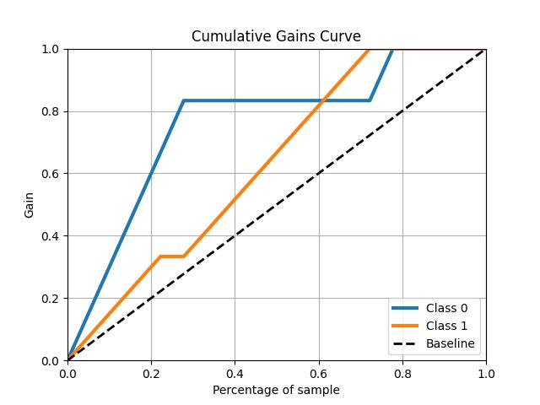
Executive Summary
Project Goals:
Develop a means to predict Successful recovery of Falcon 9 Stage 1 Boosters
Model Gains due to Prediction
Methodologies
Collect Historical Data on failed / successful Launches
Analyze Data for Predictive Patterns
Develop a classification machine model to predict successful recoveries given certain parameters
Results
Identified Predictive Factors to Successful recovery of Falcon 9 Stage 1 Boosters
Developed a classification model to accurately predict successful recoveries with 80% confidence and 80% accuracy

Slide 4
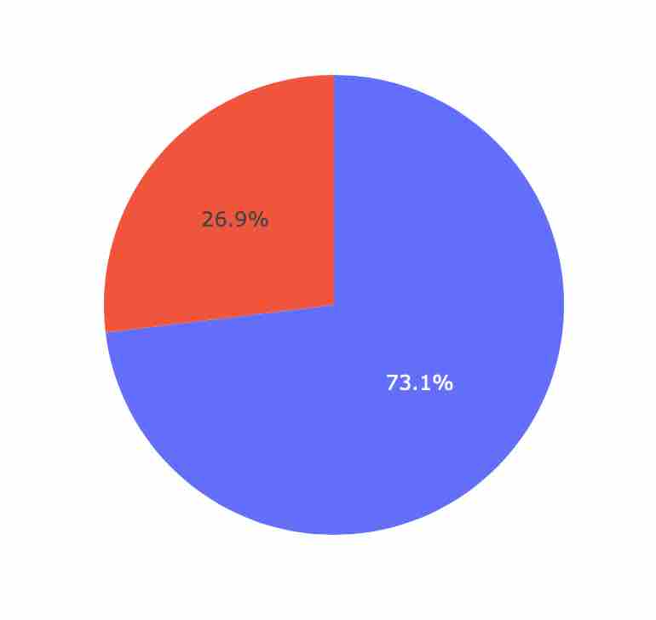
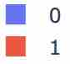
Introduction
Project background and context
SpaceX advertises Falcon9 Launches as almost half their competition. This is due largely to the ability to recover and re-use their 1st stage boosters.
Problem to Solve:
Identify what features are predictors of successful recovery
If we could accurately predict the success rate of the recovery, we could use this method to determine the actual cost per launch for future proposals.
Success vs. Failure to Recover

Slide 5

Section 1

Slide 6
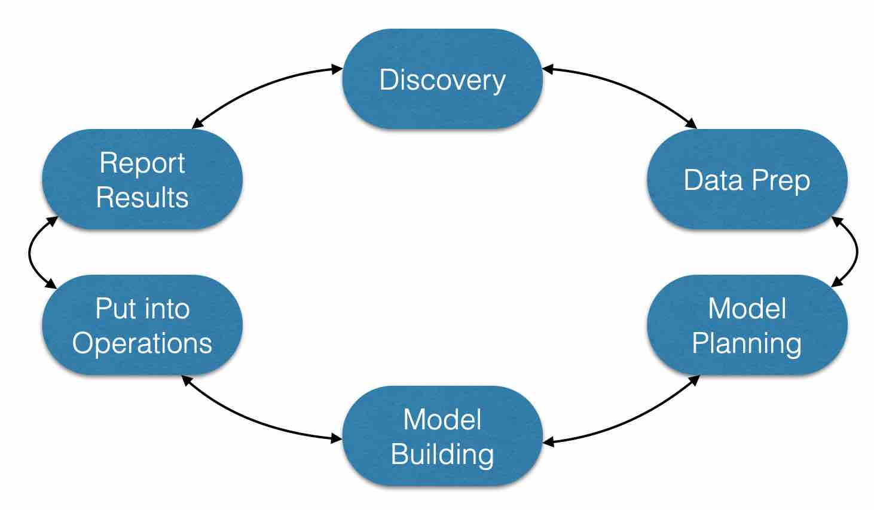
Methodology
Executive Summary
Data collection methodology:
Web Scraping from public web sites (Wikipedia)
Historical Information provided by SpaceX REST API
Perform data wrangling
Data brought together in an SQL database for initial quantative analysis
Perform exploratory data analysis (EDA) using visualization and SQL
Perform interactive visual analytics using Folium and Plotly Dash
Perform predictive analysis using classification models
Feature selection guided by EDA
Logistic Regression, SVM, KNN and Decision Tree models tested and evaluated by metric

Slide 7
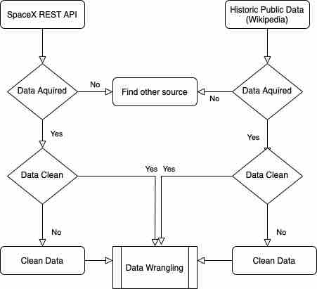
Data Collection
Historical Launch Data Sources:
SpaceX public REST API
Wikipedia.com page for Falcon 9 launches
SpaceX public Website (Pricing)
Process Methods:
Web Scraping tabular data
Normalizing JSON data from API
Missing / empty values removed
Data filtered for Falcon 9 Boosters
Missing Payload Data filled with Mean

Slide 8
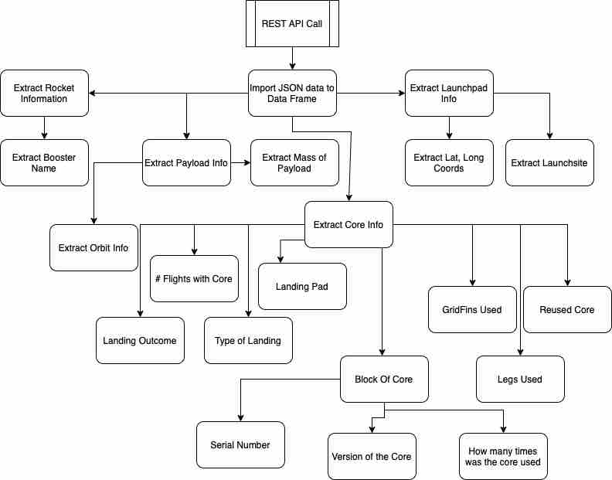
Data Collection – SpaceX API
SpaceX REST API Data:
Booster Name
Launch site Name
Coordinates
Mass of Payload
Orbit information
Landing Outcome
Number of Flights
Type of Landing
Landing Pad
Grid Fin Usage
Leg Usage
Reused Core
Booster Serial Number
Core Version
Number of Flights with particular core
Missing Payload Information filled with mean value
Data Archive:
https://github.com/Cstudent76543/Data_Collection.git

Slide 9
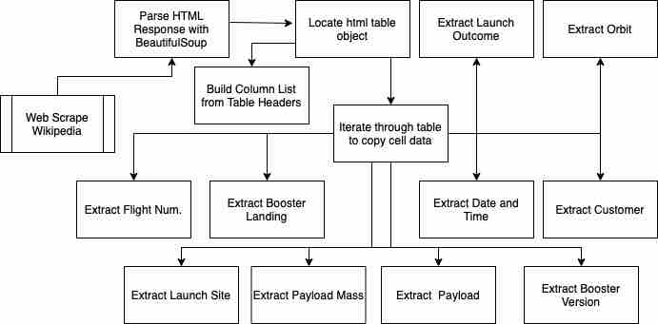
Data Collection - Scraping
Public Wikipedia information about Falcon 9:
Launch Outcome
Orbit
Customer
Date / Time
Booster Version
Payload info
Payload Mass
Launch Site
Booster Landing
Flight Num.
Data Archive:
https://github.com/Cstudent76543/WebScrape.git

Slide 10
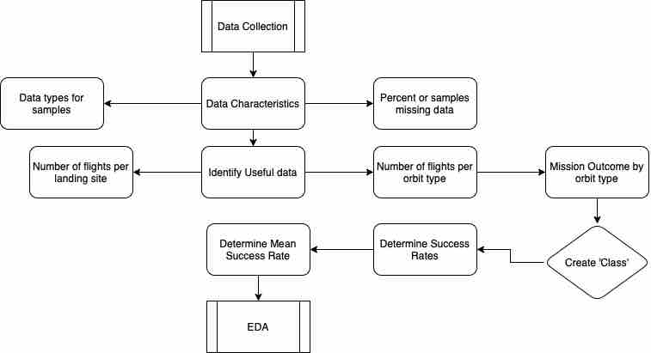
Data Wrangling
Data Loaded from CSV
Characterize the data:
Quantify missing values
Validate data types
Collect number of flights per landing site
Collect number of flights by orbit
Collect mission outcome by orbit
Feature Engineering
Create a Categorical Feature ‘Class’ to identify successful and failed landings
Collect Success Rates
Calculate average success rate
Data Archive:
https://github.com/Cstudent76543/Data-Wrangle.git

Slide 11
EDA with Data Visualization
Charts Selected for EDA
Payload Mass vs. Flight Number
Scatter Plot & Time Series
Success Increased as Flight numbers increased
Massive payloads were less likely to return
Launch Site vs. Flight Number
Scatter Plot & Time Series
Frequency of launches per site
As success became more common, other sites used
Payload Mass vs Launch Site
Scatter Plot & Time Series
Some sites did not deal with Massive Payloads
Success Rate vs. Orbit Type
Some orbits had much higher success rates than others
Data Archive:
https://github.com/Cstudent76543/Data_Visualization.git
Flight Number vs. Orbit Type
Very Low Earth Orbit Flights occur later
Some orbits have little correlation with flight number
Payload Mass vs. Orbit Type
Some orbits were more successful with massive payloads
Launch Success by Year
Launch Success increased by year
~5% in 2015 -> ~60% in 2020

Slide 12
EDA with SQL
SQL Queries run on data:
Unique Launch Site Names
Selected 5 launches from sites beginning with ‘CCA’
Calculated total Payload Mass (kg) for all missions on behalf of NASA
Calculated mean Payload mass for the Falcon 9 booster v1.1
Listed date of first successful landing to a ground pad
Selected names from Boosters with mass between 4000 & 6000 successfully landing on drone ships
Selected Total success and failure outcomes from all the missions
Selected Booster Versions having carried the maximum payload
For 2015, Display months with failure outcomes on droneships, launch site and booster versions.
From 20100604 to 20170320: Count successful landing outcomes
Data Archive:
https://github.com/Cstudent76543/SQL_EDA.git

Slide 13
Build an Interactive Map with Folium
Folium Objects generated:
Map Object:
The Background map where all the other objects are placed
Circle Objects:
Created location shading around each launch site region
Marker Objects:
Marked Prominent nearby features for each launch site
Marked each launch site
Color coded mission success and failure by launch site and mission number
MarkerCluster Object:
Collected each launch outcome at each launch site
MousePosition Object:
Displayed lat long for feature identification and distance calcs
PolyLine Object:
Graphically represent distance from the launch site to various prominent features
Data Archive:
https://github.com/Cstudent76543/Folium_notebook.git

Slide 14
Build a Dashboard with Plotly Dash
Dashboard Components
Site Selection Drop Down:
Default to ‘ALL’ – Gives overview of success rate for all sites, easy to identify higher rates
Per Launch Site: Allowed a deeper dive into the success rates and frequency at each particular site
Success Rate Pie Charts:
Frequency of Success and total missions from each site
Payload Range Slider:
Provided an easy way to visualize how payload impacted success rate by launch site
Payload Mass vs. Mission Outcome Scatter Chart:
Classified by mission outcome, easy to identify correlation between sites and payload on mission outcome
Data Archive:
https://github.com/Cstudent76543/Plotly_Dash.git

Slide 15
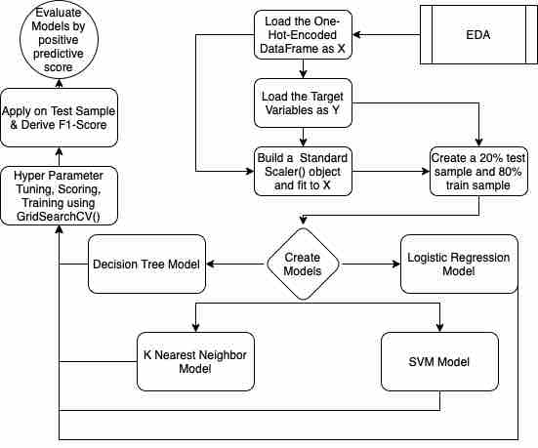
Predictive Analysis (Classification)
Model Development & Assessment
One-Hot-Encoded Independent Variables
Scaled Independent Variables to common range
Set aside 20% of samples for testing
Built 4 different classification models
Performed hyperparameter tuning for f1 score and k-fold validation using GridSearchCV()
Tested each model on Test Data
Further assessment for Positive Predictive score from confusion matrix
Calculated Relative impact of predictive features on successful recovery of Falcon 9 boosters
Data Archive:
https://github.com/Cstudent76543/Model_Development.git

Slide 16
Results
Exploratory data analysis results
Predictive Features Identified
Grid Fins & Legs, Serial number of the booster, orbit, payload, launch site, re-use of the booster all play important roles in the successful recovery of the Falcon 9 boosters. Launches have been increasing success frequency over time, from 5% -> 60% in under a decade.
Strong trends in payload, orbit, launch site and flight number to successful outcomes.
Interactive analytics: See Below Sections for Screen Shots
Some Launch sites have had higher frequency of success in recovery of the Falcon 9 Boosters, but this is likely due to the payload and destination orbit of later launches.
Predictive analysis results
While three of the 4 chosen models achieved 88% in harmonic accuracy (f1-Score) the logistic regression model lends itself better to our use case. The ability to generate consistent direct probabilities without additional pre-processing is exactly what we want to address the original problem.
i.e. To predict which launches will result in a successful landing, we want to assign a probability to the outcome and have confidence in that prediction when it occurs.
The Logistic Regression Model satisifies this requirement with 80%+ F1 score and 80% Positive Predictive score.

Slide 17

Section 2

Slide 18
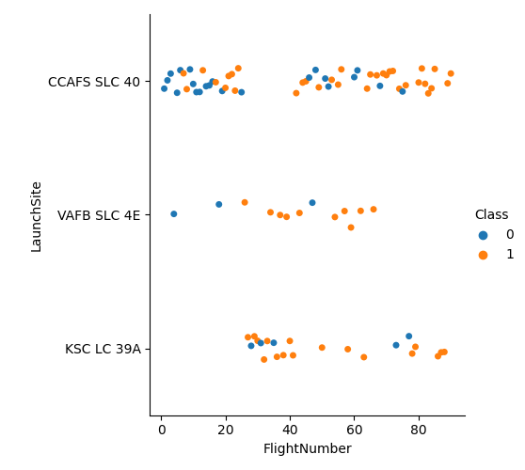
Flight Number vs. Launch Site
CCAFS SLC-40 was the primary launch site for early, failure prone launches. It remains the highest frequency launch site.
After ~20 launches the success rate began to climb at all sites and KSC-LC 39A started to be used.
KSC-LC 39A has a high frequency of success.

Slide 19
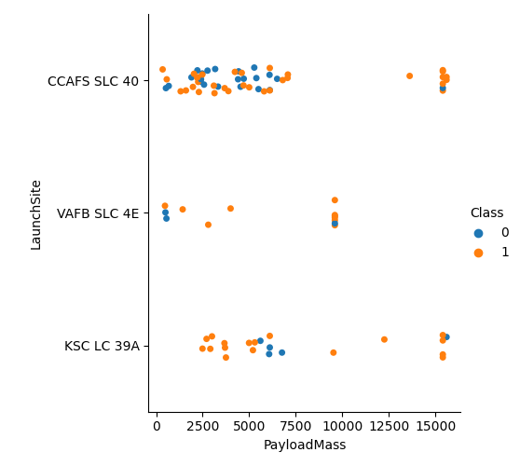
Payload vs. Launch Site
VAFB SLC-4E has not launched a payload over 10000 kg in the sample data.
CCAFS SLC-40 has a wide range of payload mass in it’s launch history. Most of the heaviest payloads successfully launched with a recovered Falcon 9 booster come from this site.

Slide 20
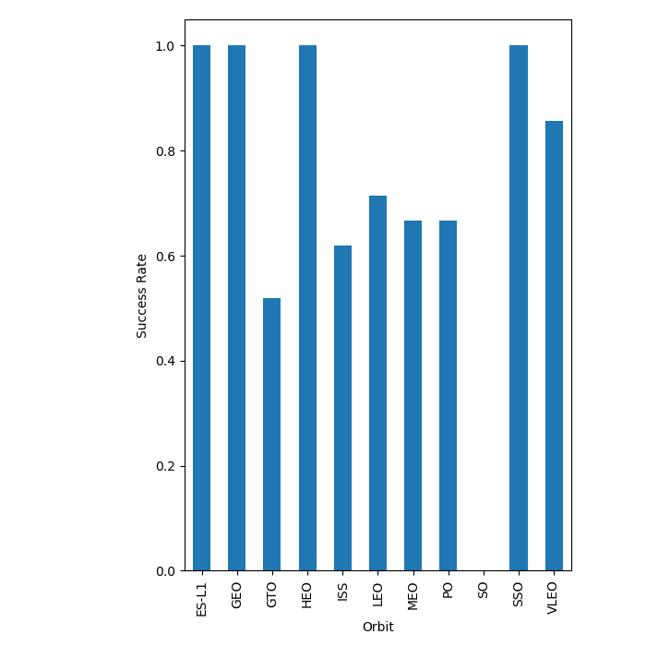
Success Rate vs. Orbit Type
SSO, HEO, GEO and ES-L1 Orbits have close to 100% success rates in recovery of the booster.
VLEO orbits have success rates over 80%.
GTO Orbits are the worst orbits, only about 50% success rate.

Slide 21
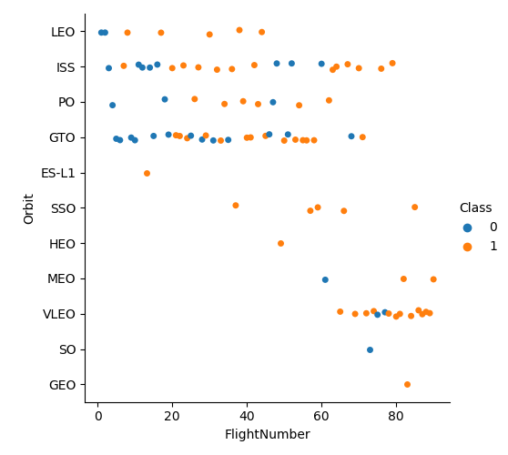
Flight Number vs. Orbit Type
VLEO Launches have only recently been done, which could explain their higher success rate in recovery.
GTO and ISS orbits have continued to be prone to failure despite higher flight numbers.

Slide 22
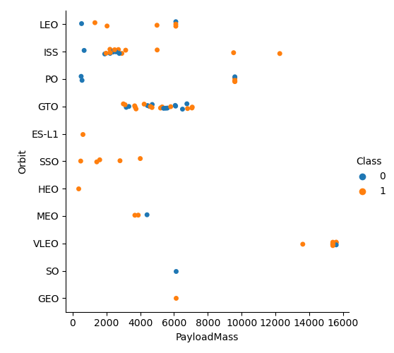
Payload vs. Orbit Type
GTO Orbits seem to be unaffected by Payload Mass.
Almost all VLEO Orbit missions were performed with close to Maximum payload mass.
Most missions carry between 2000 and 6000 kg in payload mass.

Slide 23
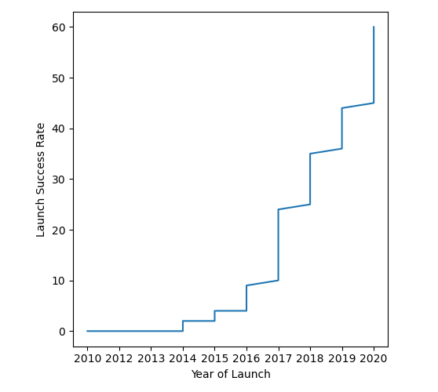
Launch Success Yearly Trend
Successful recovery of the Falcon 9 booster has become more frequent with time.
From ~5% in 2015 to nearly 60% in 2020.
As flights continue, they are likely to result in more successful booster recovery efforts.

Slide 24
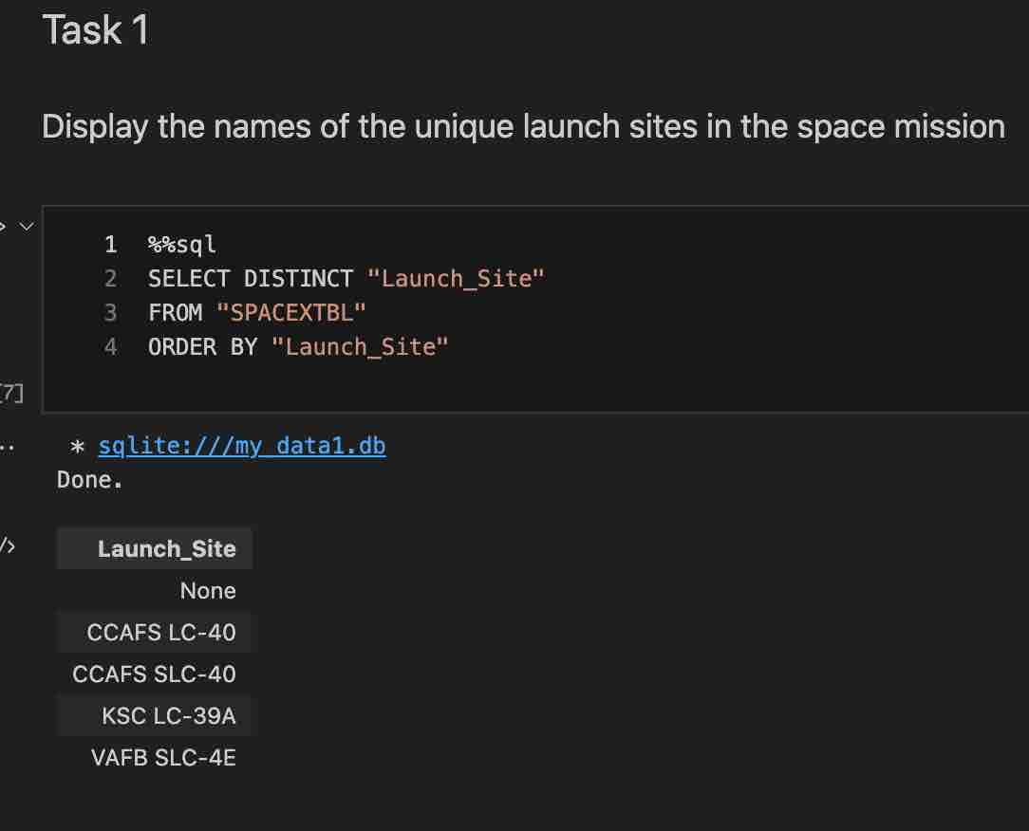
All Launch Site Names
Find the names of the unique launch sites
The Unique names were pulled from the SQL database table with a SELECT statement combined with DISTINCT

Slide 25
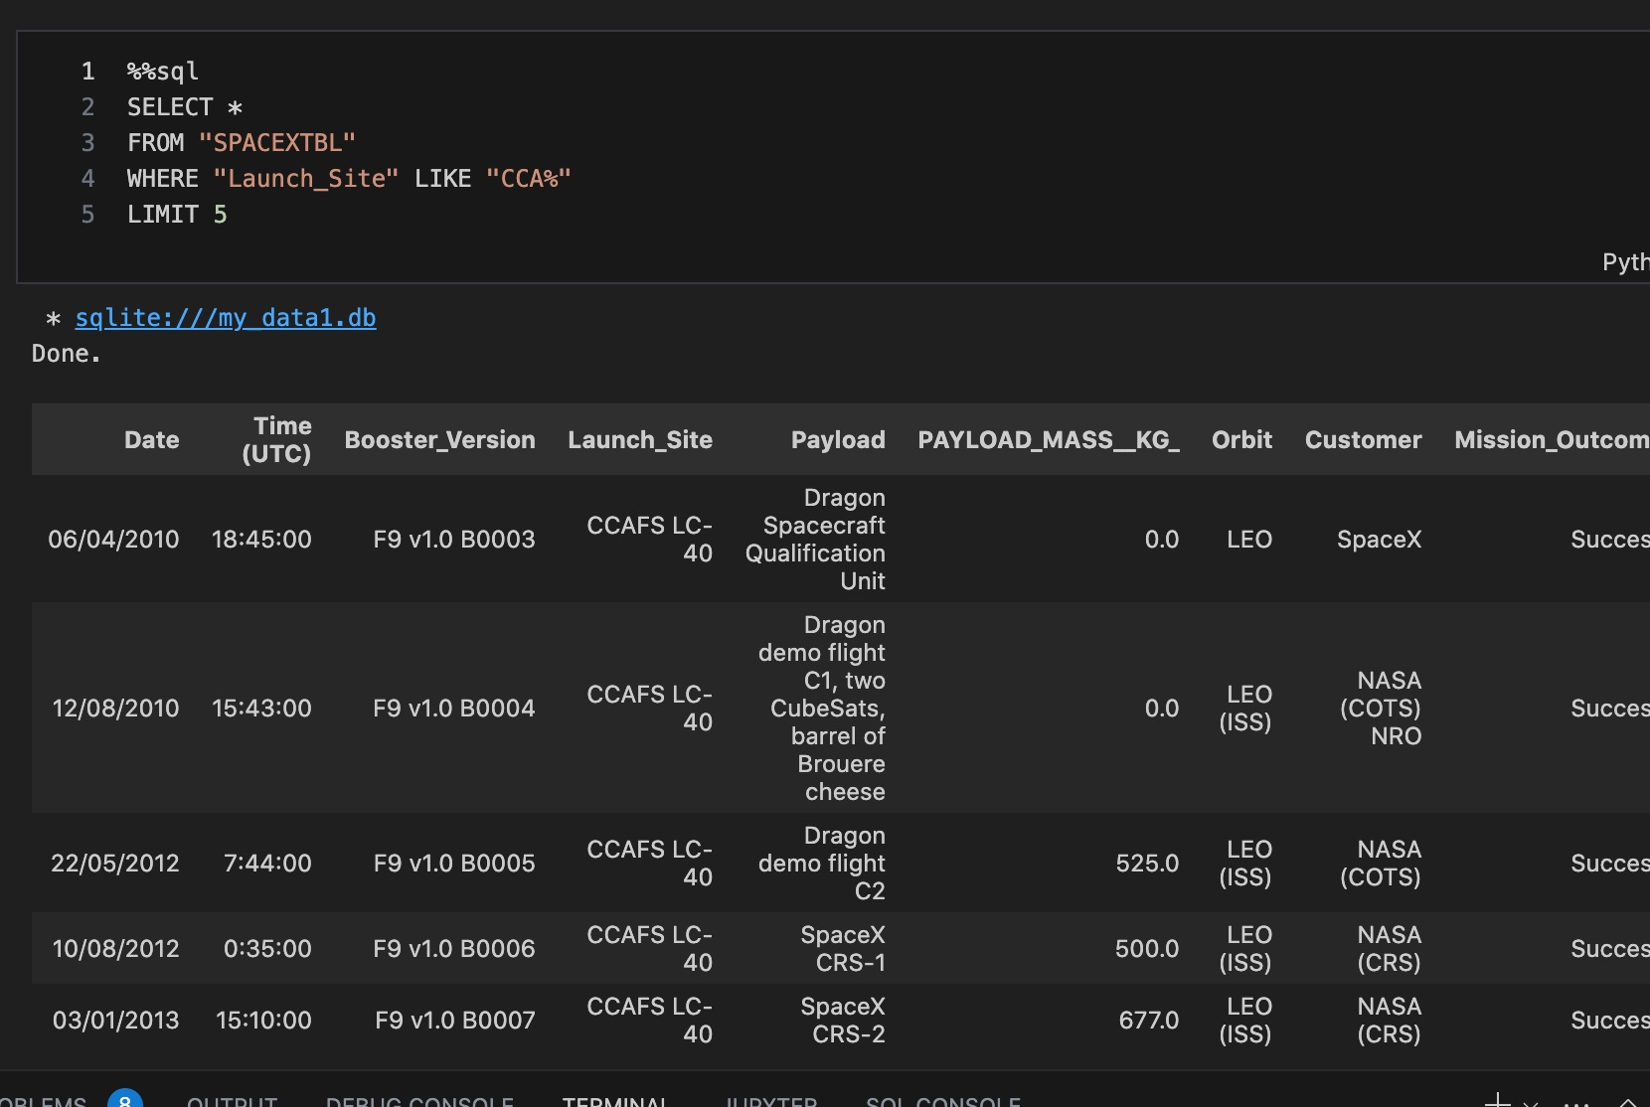
Launch Site Names Begin with 'CCA'
Find 5 records where launch sites begin with `CCA`
Applying WHERE, LIKE and LIMIT clauses to the SELECT statement generated this list.

Slide 26
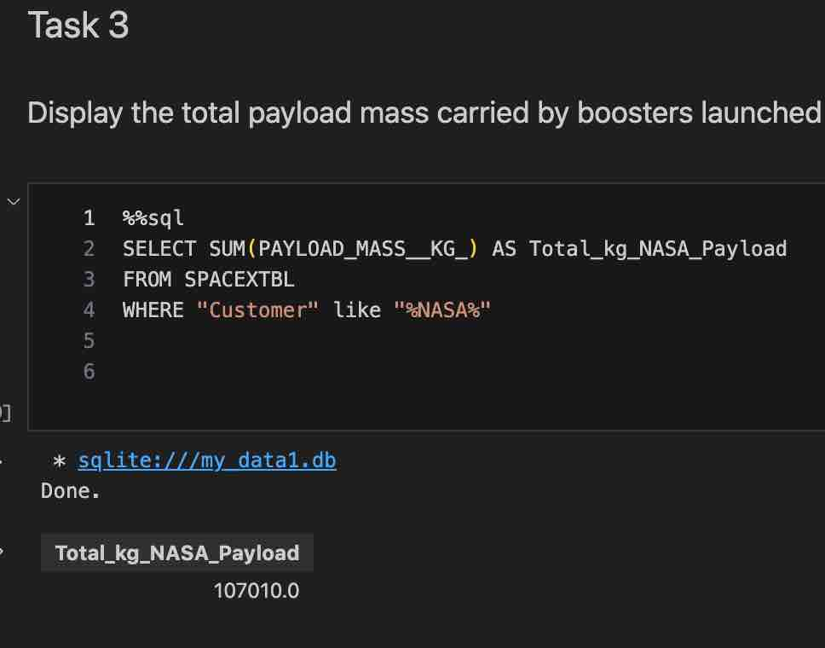
Total Payload Mass
Calculate the total payload carried by boosters from NASA
Used the SUM() function combined with WHERE and LIKE with the SELECT Statement

Slide 27
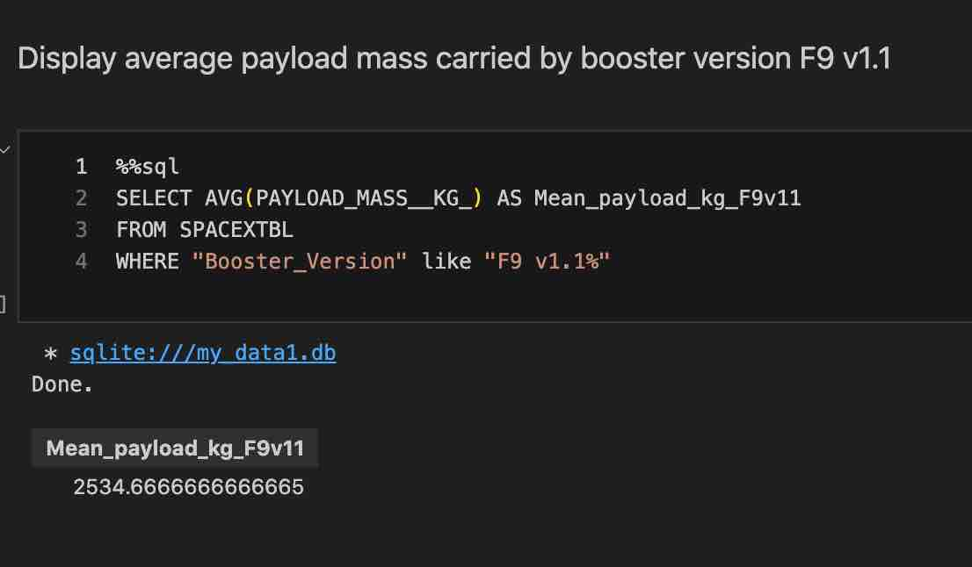
Average Payload Mass by F9 v1.1
Calculate the average payload mass carried by booster version F9 v1.1
Applied the AVG() function combined with a WHERE and LIKE clause for the SELECT statement.

Slide 28
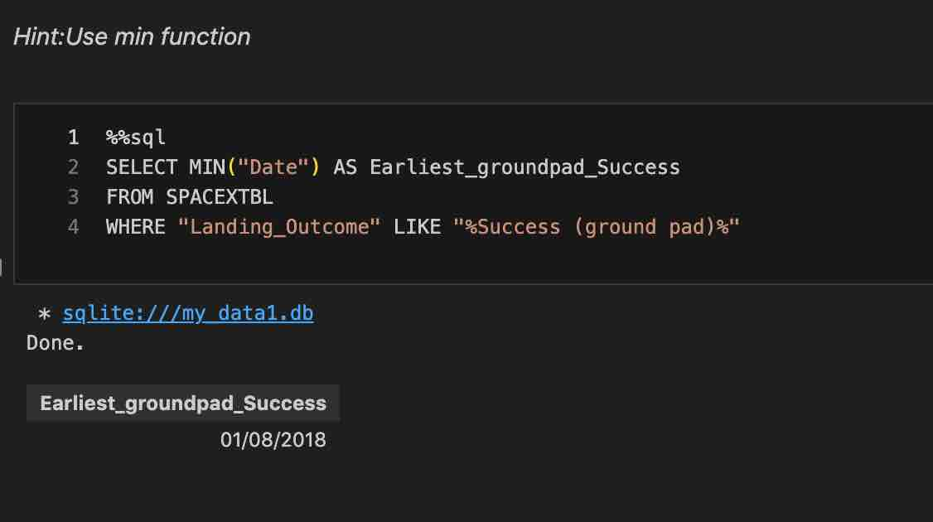
First Successful Ground Landing Date
Find the dates of the first successful landing outcome on ground pad
Applied the MIN() function in combination with WHERE and LIKE clauses to the SELECT statement.

Slide 29
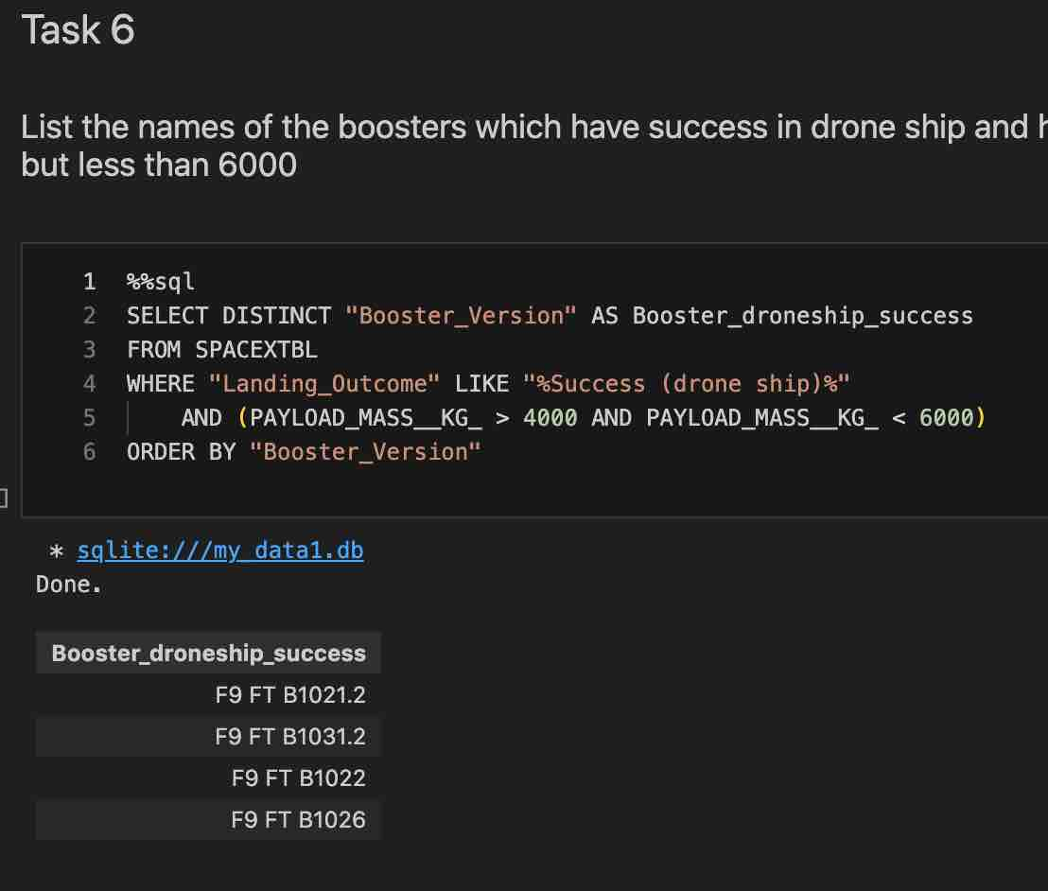
Successful Drone Ship Landing with Payload between 4000 and 6000
List the names of boosters which have successfully landed on drone ship and had payload mass greater than 4000 but less than 6000
Used Logical Operators in the WHERE clause to combine the Landing Outcome with Success.

Slide 30
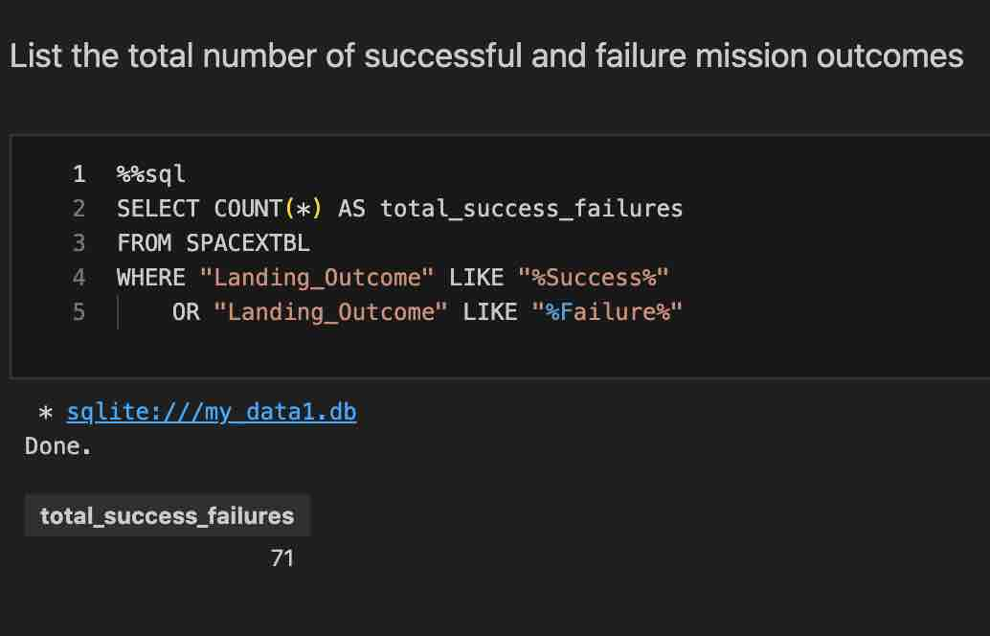
Total Number of Successful and Failure Mission Outcomes
Calculate the total number of successful and failure mission outcomes
Used the COUNT() function in combination with logical OR in the WHERE clause for the SELECT statement

Slide 31
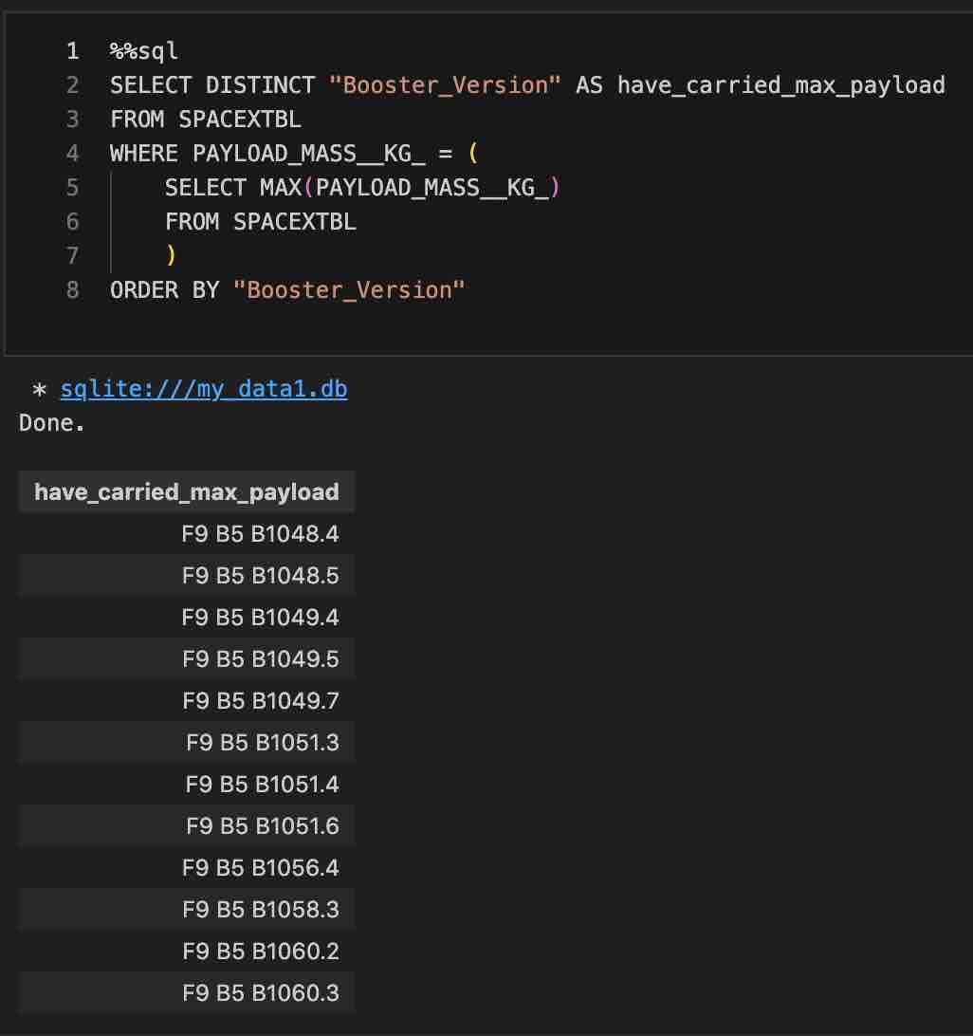
Boosters Carried Maximum Payload
List the names of the booster which have carried the maximum payload mass
Used a sub-query in the WHERE clause to calculate the maximum payload and compare it to a given records payload value.
Of those returned records, select the DISTINCT version values to display.

Slide 32
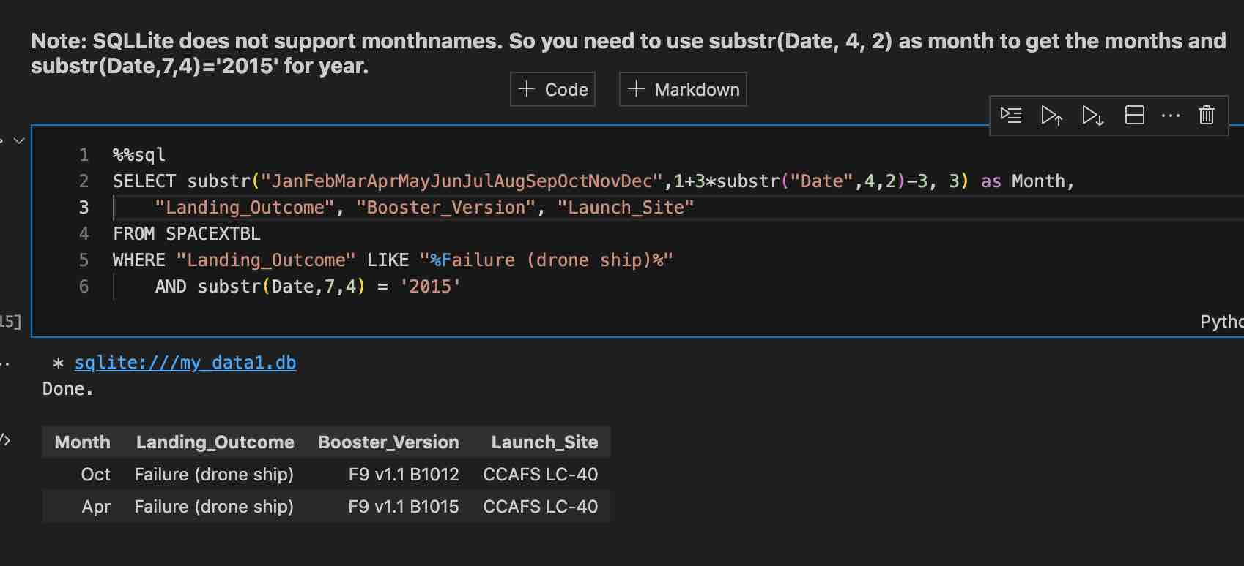
2015 Launch Records
Used the substr() function to parse the date field and assign a month name and to provide a logical operator in the WHERE clause.

Slide 33
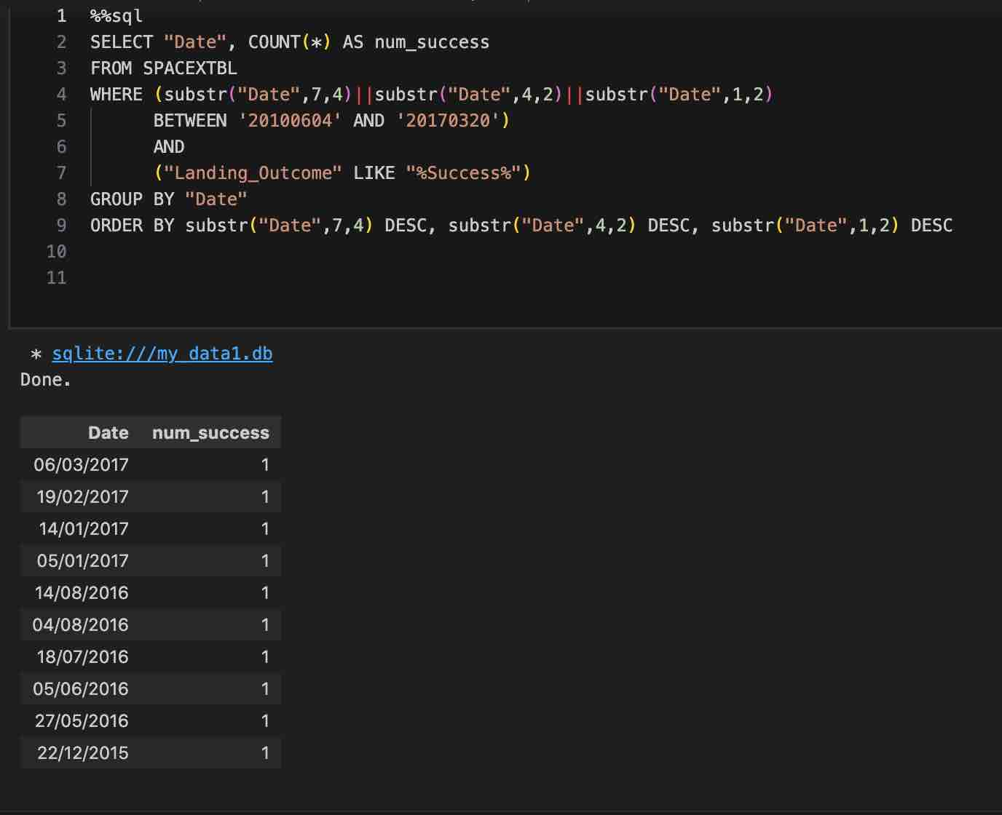
Rank Landing Outcomes Between 2010-06-04 and 2017-03-20
Rank the count of landing outcomes (such as Failure (drone ship) or Success (ground pad)) between the date 2010-06-04 and 2017-03-20, in descending order
Heavy use of Substr to parse the date field and use the BETWEEN operator.
GROUP BY and ORDER BY required.

Slide 34

Section 3

Slide 35
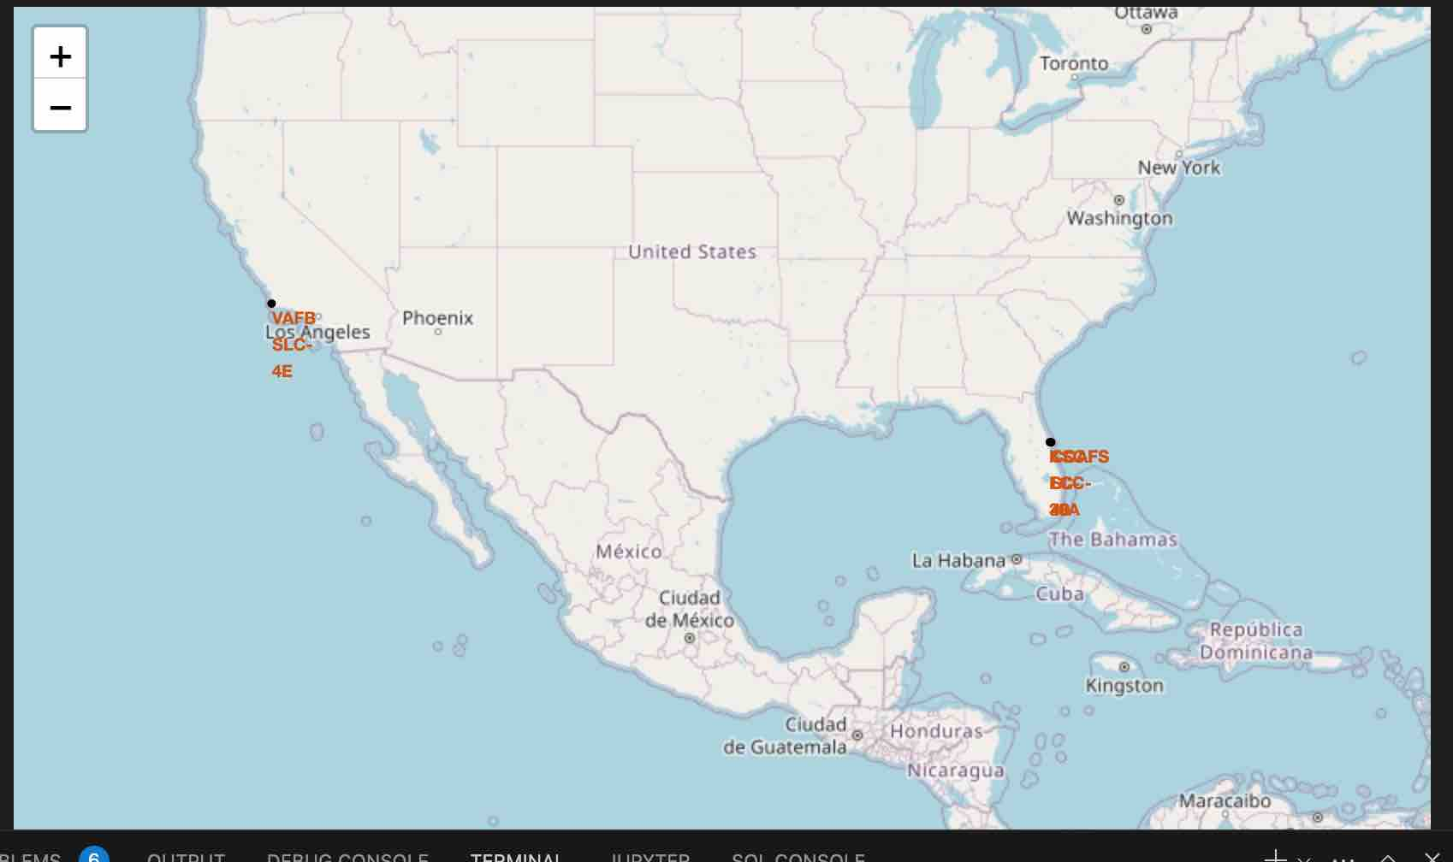
GeoSpatial Data for Launch Sites
All Launch sites are in the southern region of the US located very close to the coast but distanced from major population centers.

Slide 36
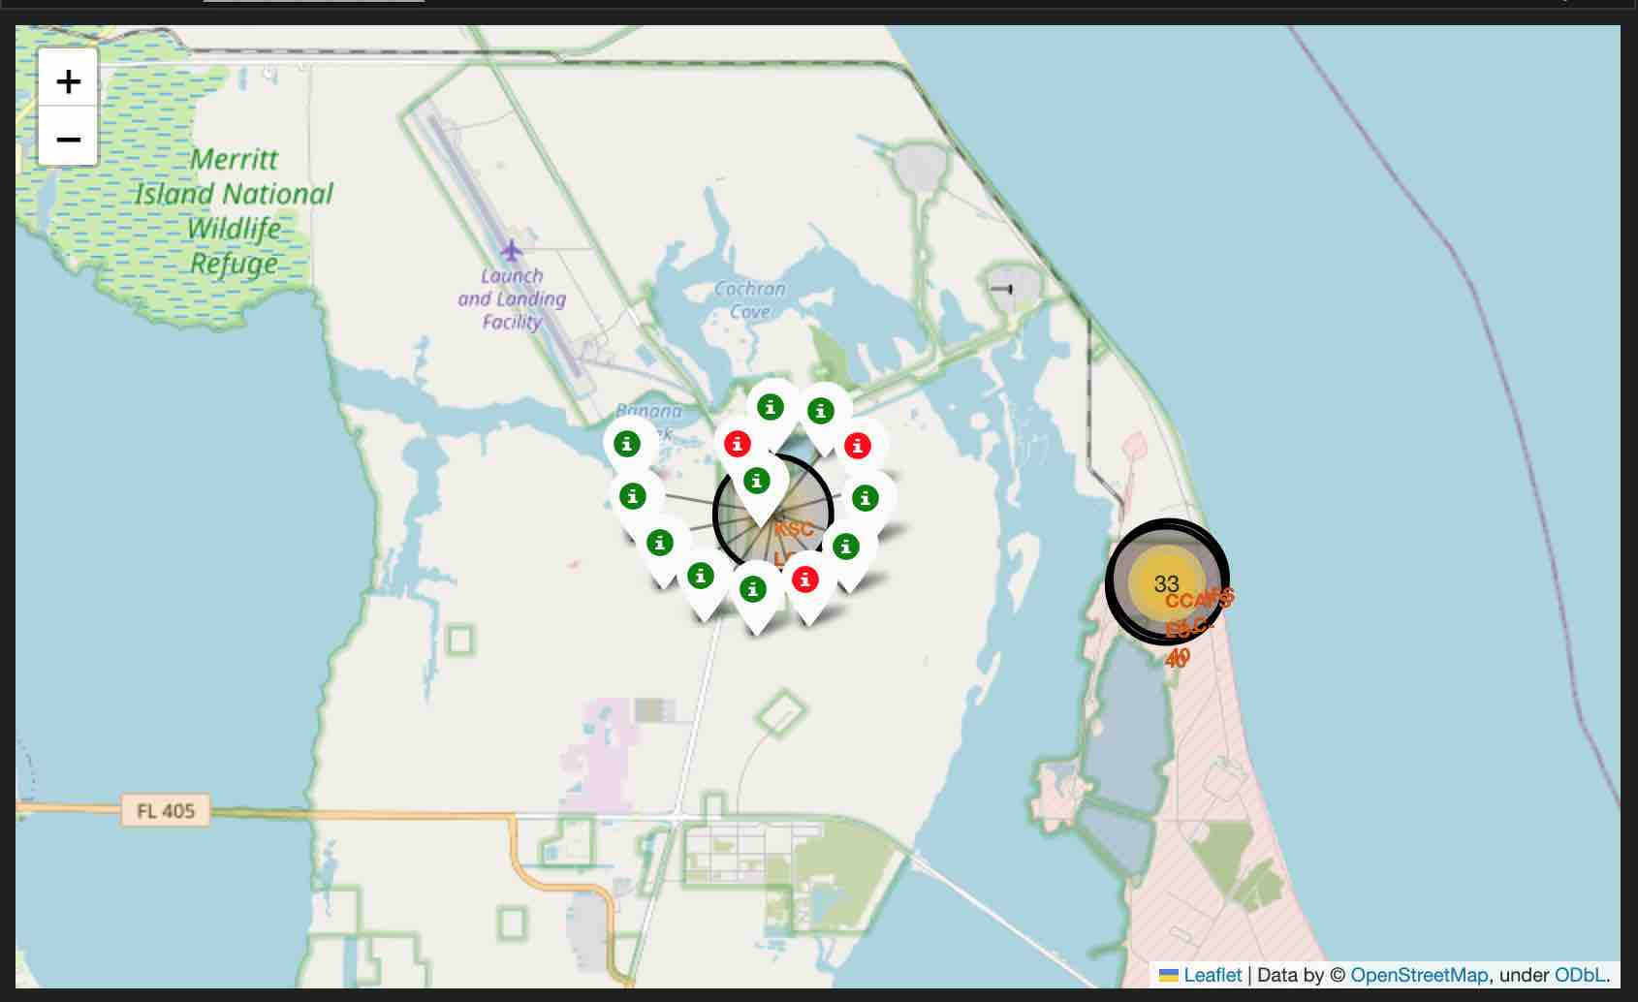
Recovery Success by Launch Site
Some Launch Sites had a much higher frequency of success.

Slide 37
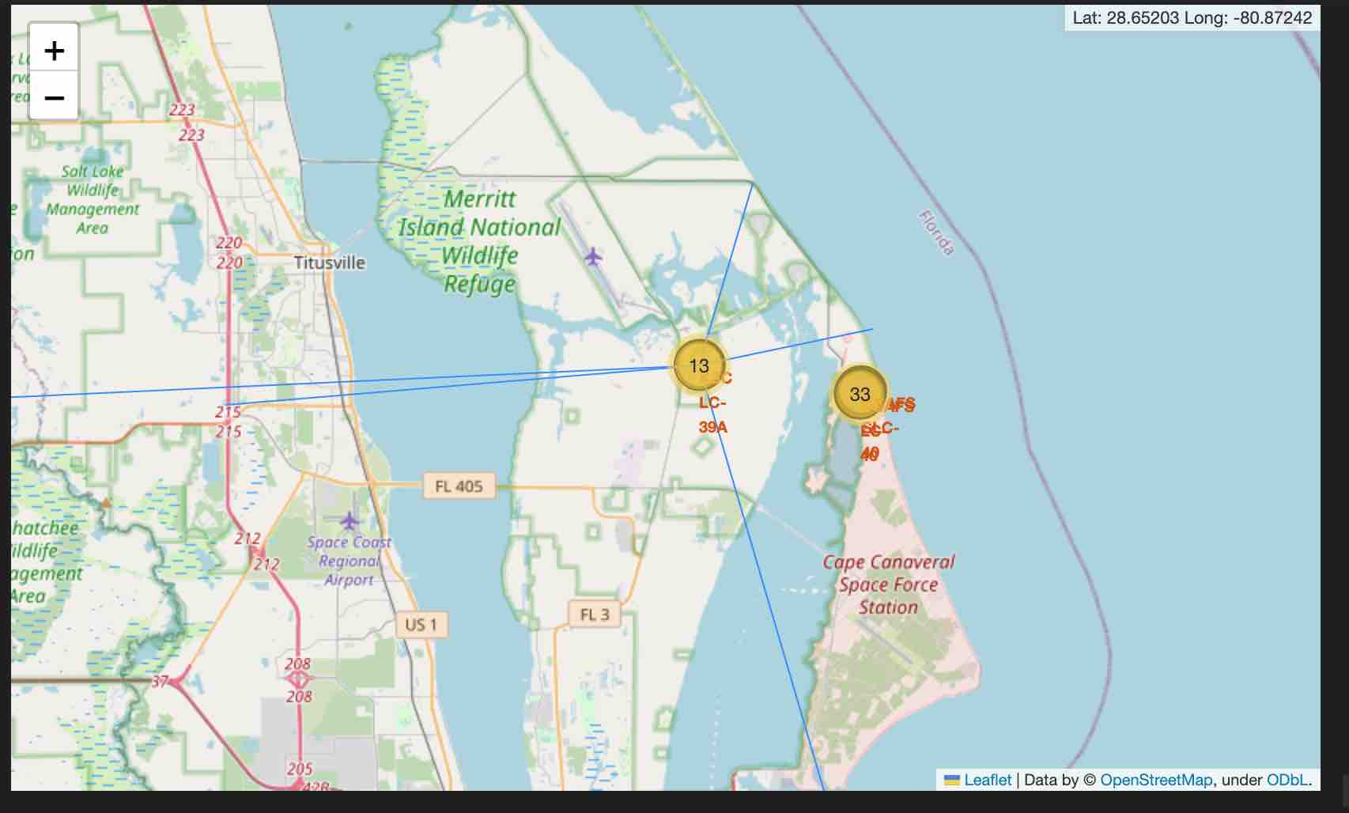
Proximity of Launch Sites to Landmarks
The launch sites tend to be distant from major population centers but reasonably close to railways and highways.
This could be due to the US N/S highways and railroads hugging the coast.
If you are near the coast, you are near a major highway and railroad almost anywhere in the US

Slide 38

Section 4

Slide 39
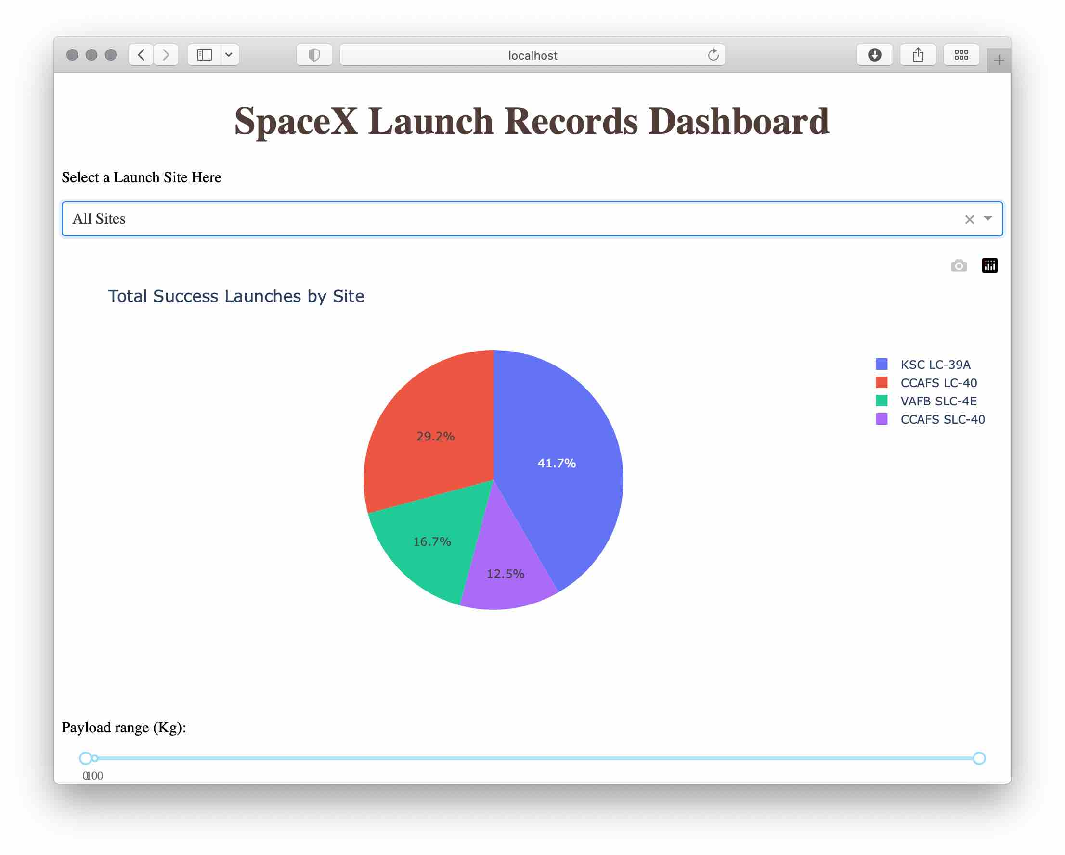
Success Rates by Site
KSC-LC39A Has the highest frequency of successful launches
CCAFS LC-40 has the second highest.
No site has over 50% success rate.

Slide 40
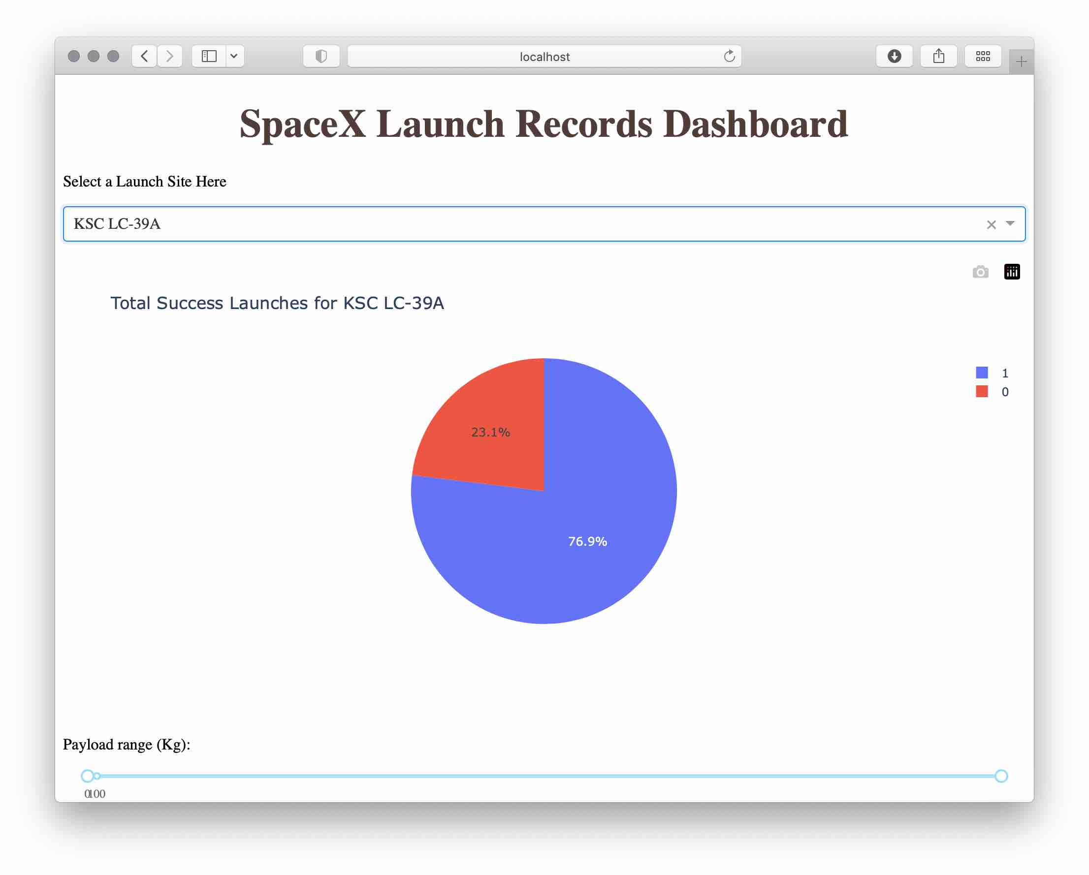
Success Rate for KSC LC
Over 76% of all launches from KSC LC-39A have resulted in successful recovery of the Falcon 9 Booster.

Slide 41
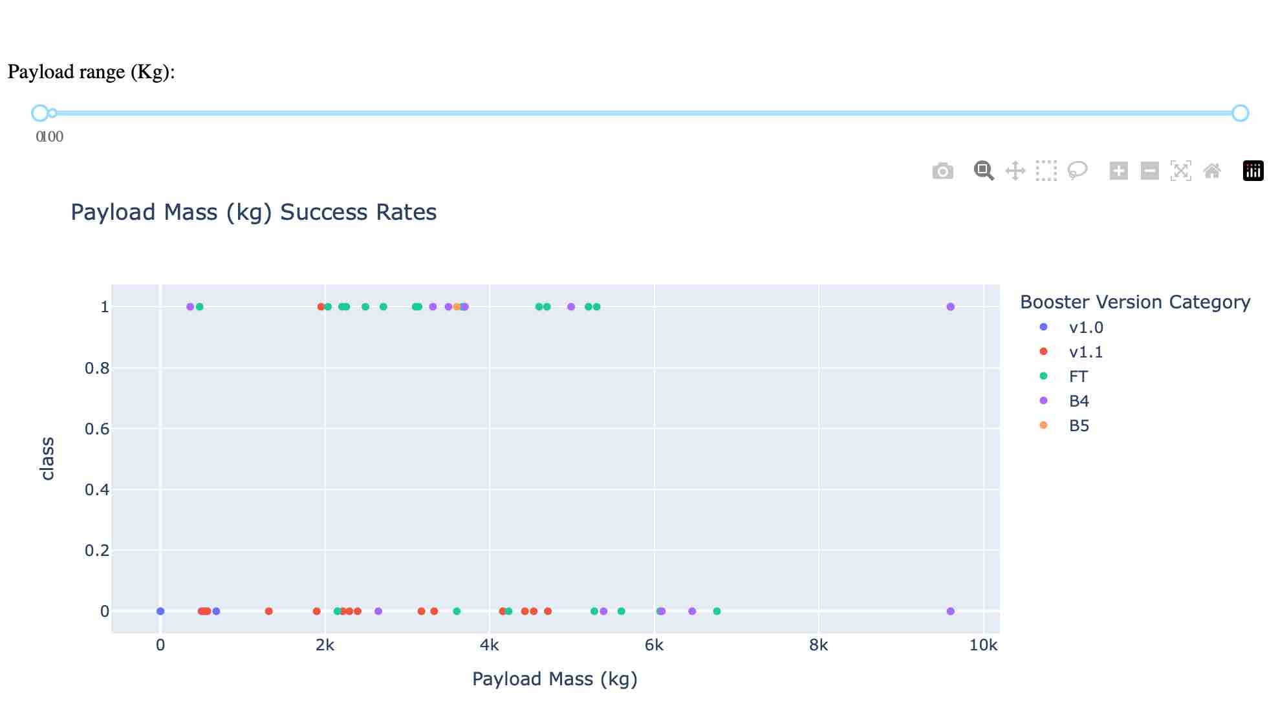
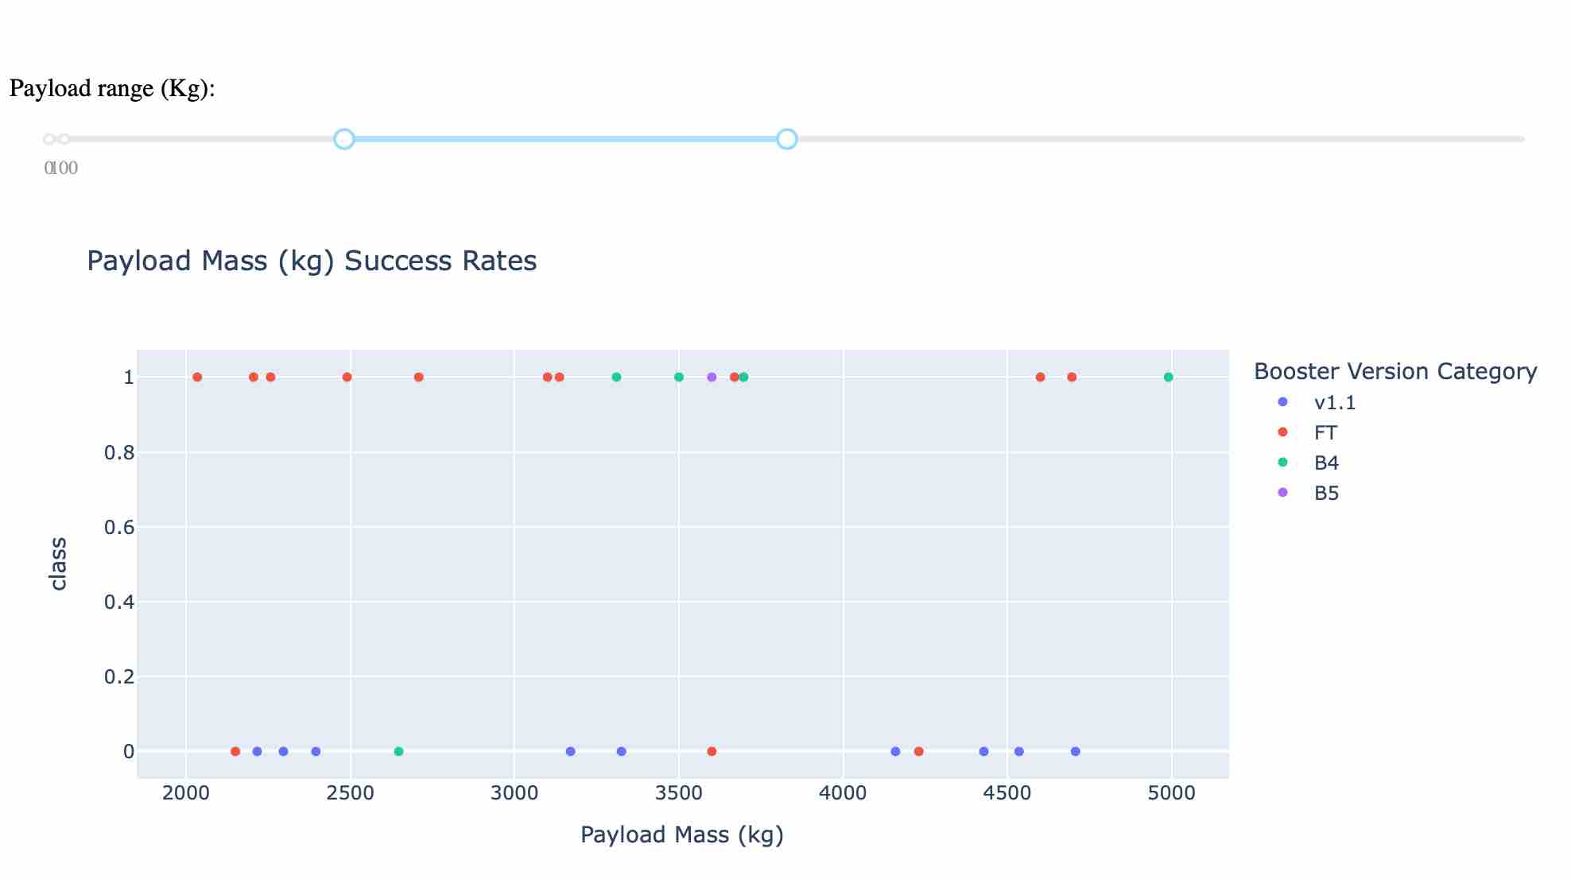
Payload vs. Success Rate All Sites
The FT Booster version seems more successful over the entire range of payloads
The v1.1 Booster does not have a good success rate, frequently resulting in a failed recovery

Slide 42

Section 5

Slide 43
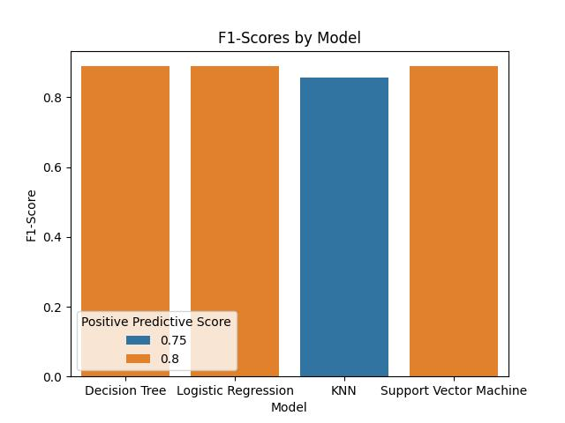
Classification Accuracy
Decision Tree, Logistic Regression and SVM machines achieved over 80% F1 score.
In addition all three achieved 80% on their Positive Predictive Score.
Logistic Regression provides direct probabilities of success and is the best model for this problem.

Slide 44
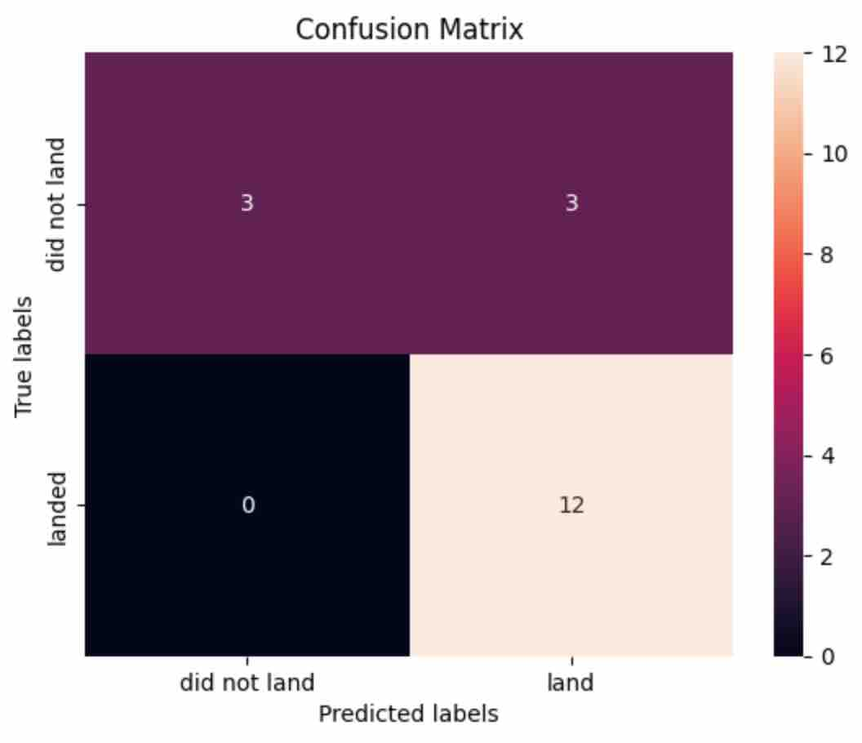
Confusion Matrix
The confusion Matrix for the Logistic Regression model shows all 12 of 12 True Positives of the test sample were predicted correctly.
3 of the Failed recoveries were mis-classified as Fase Positives.
This represents an 80% positive predictive confidence in the model to predict on onseen data

Slide 45
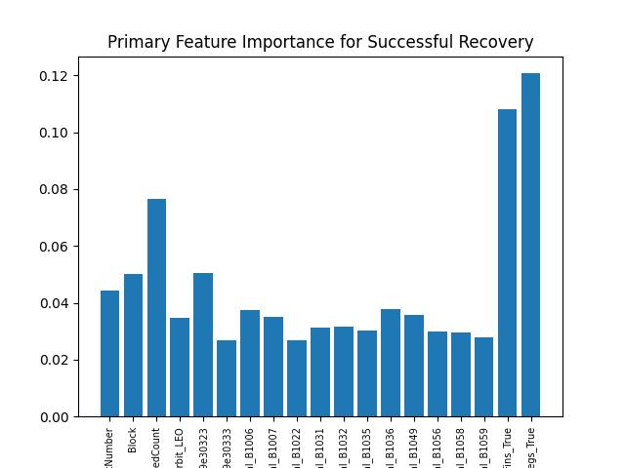
Conclusions
Grid Fins and Legs are the most predictive factor for successful recovery of the Falcon 9 Booster
This is followed by the re-use count of the booster. ‘It worked before..’
We can predict successful recovery of the Falcon 9 boosters with ~80% accuracy and confidence
Recovery rates will likely continue to increase over time.

Slide 46
Appendix
Include any relevant assets like Python code snippets, SQL queries, charts, Notebook outputs, or data sets that you may have created during this project

Slide 47
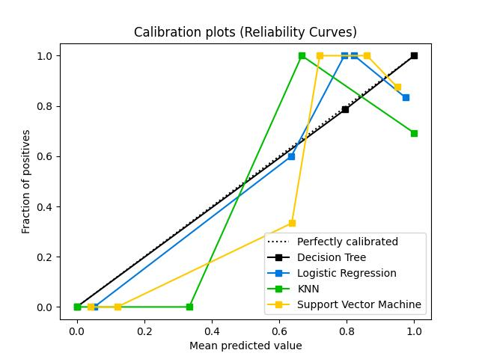
Model Calibration Comparison

Slide 48
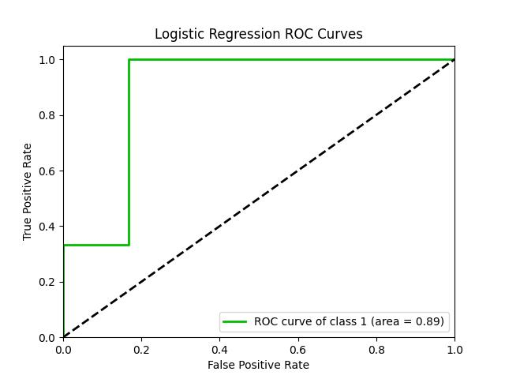
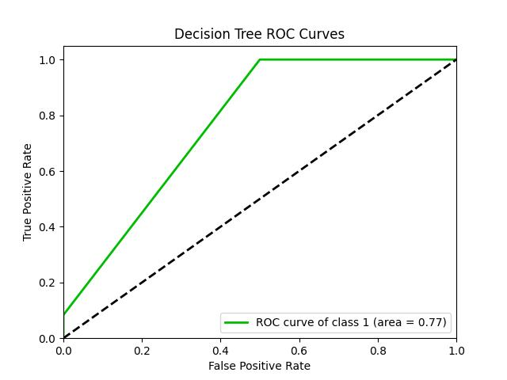
Model Calibration Comparison

Slide 49
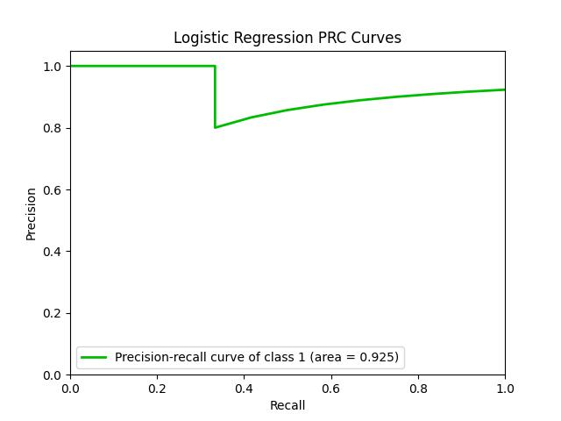
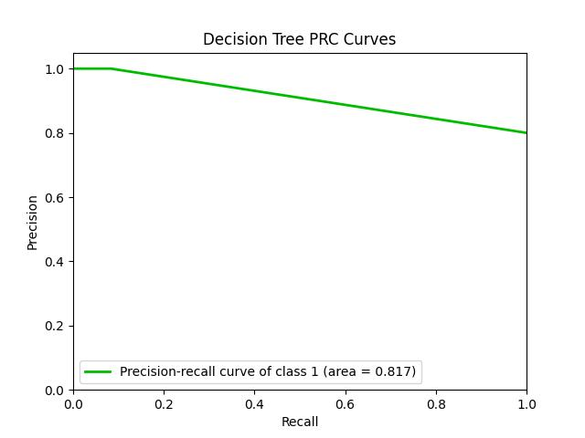
Model Calibration Comparison

Slide 50


